Slide 1
Predicting Steam Prices Using G2A and Steam Data
Steve Setteducati Jr.

Slide 2
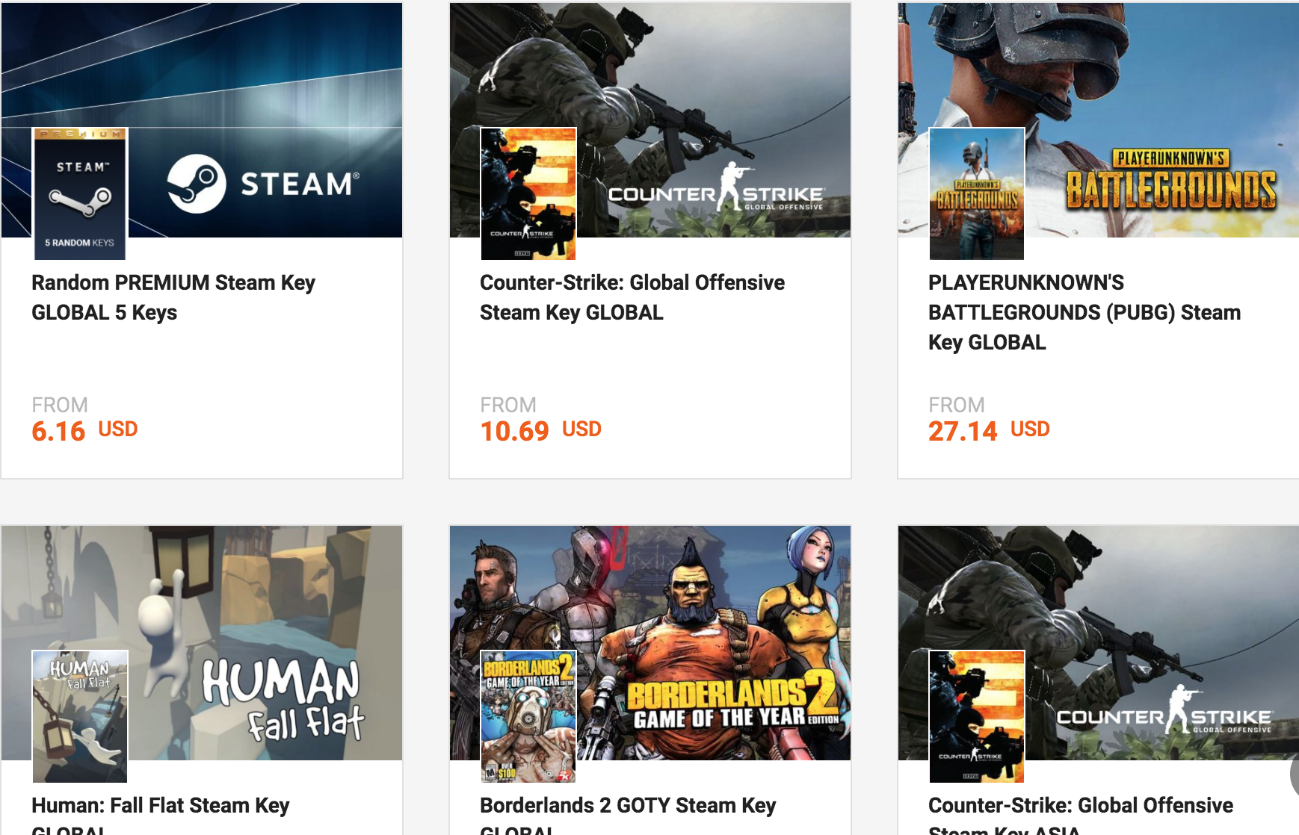

Business Understanding
Steam is a PC gaming platform
G2A.com’s business model is being a cheaper key reseller than Steam
Many Publishers and Developers can be the same
As time goes on, Steam Prices decrease
Some Genres are more successful than others and some Genres have a longer life than others

Slide 3
Data Understanding: Collection Plan
Make SQLite DB
Collect G2A Data
Collect Steam AppId’s
Match G2A Name to Steam Name/AppId
Collect Steam Data

Slide 4
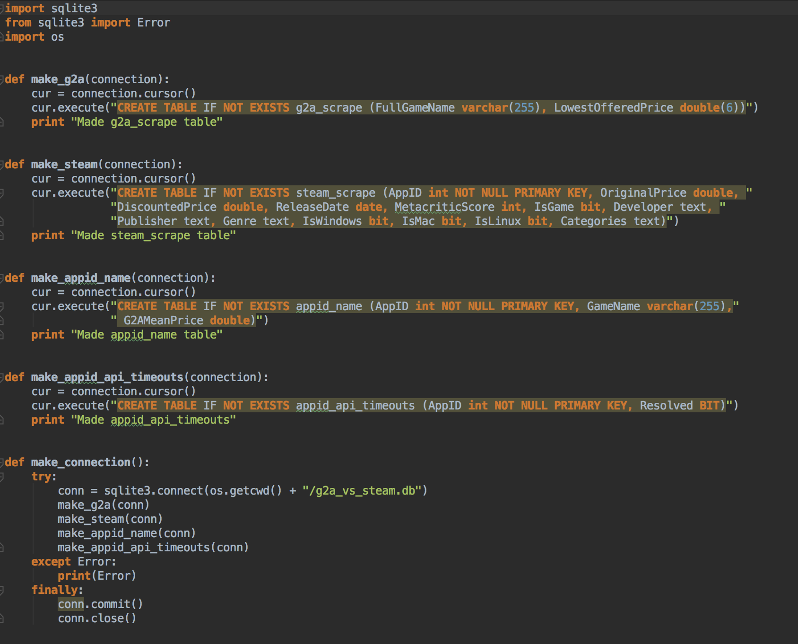
Data Understanding: Making SQLite DBs

Slide 5
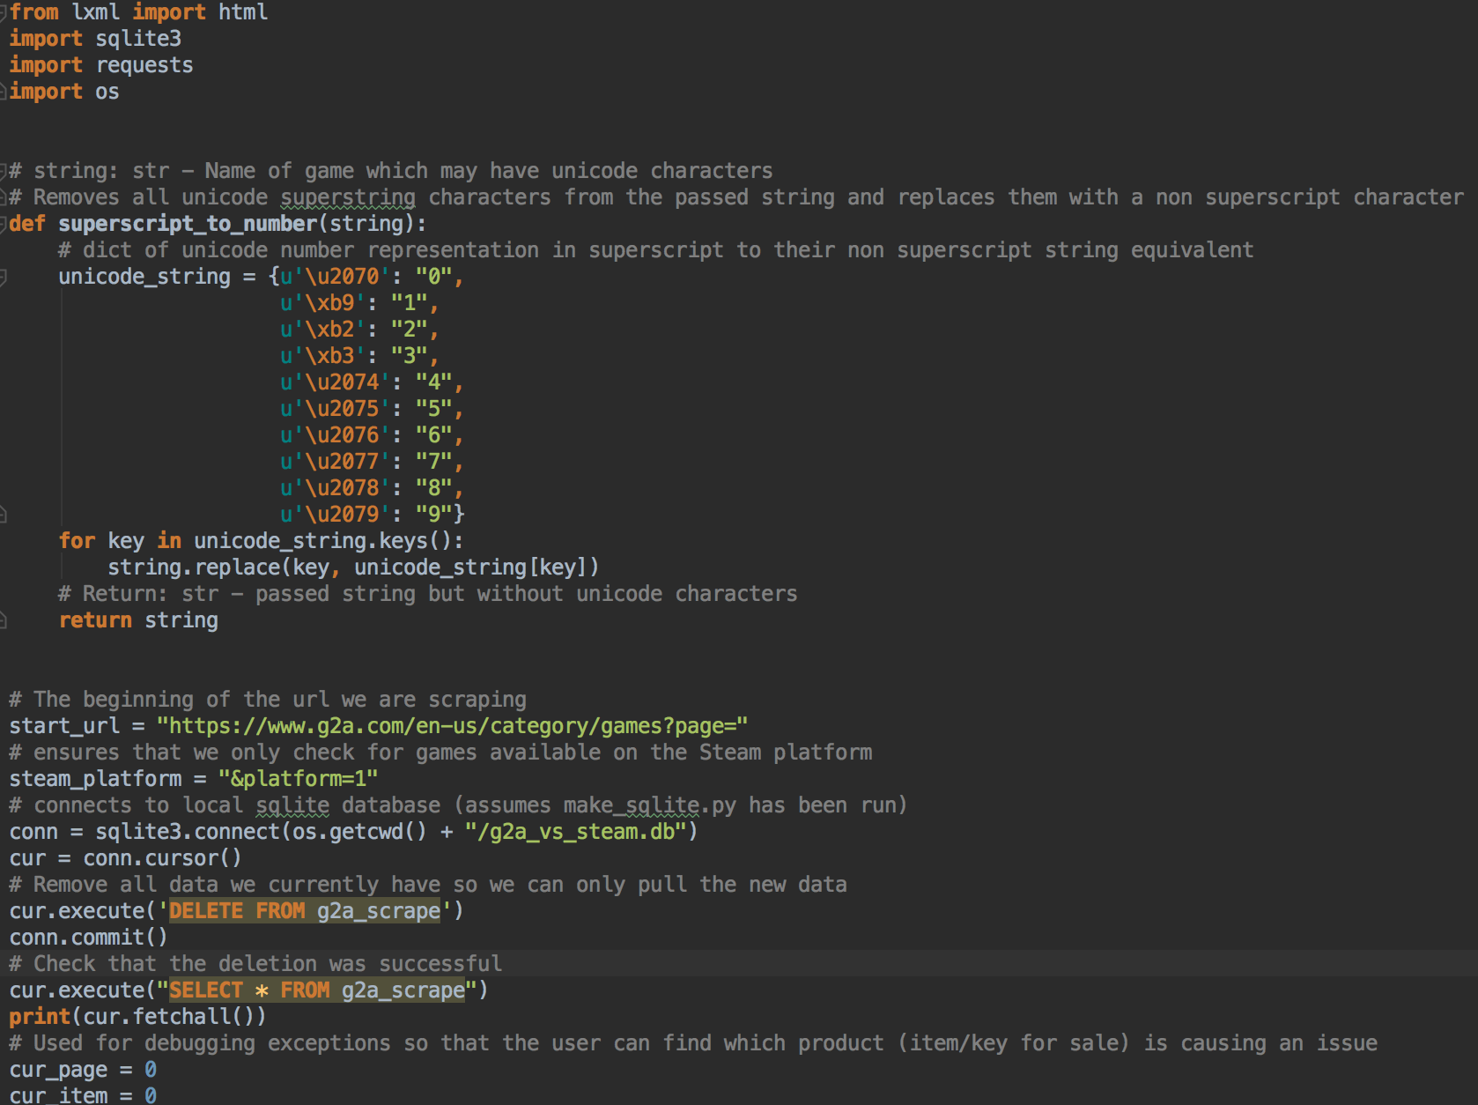
Data Understanding: Collect G2A Data

Slide 6
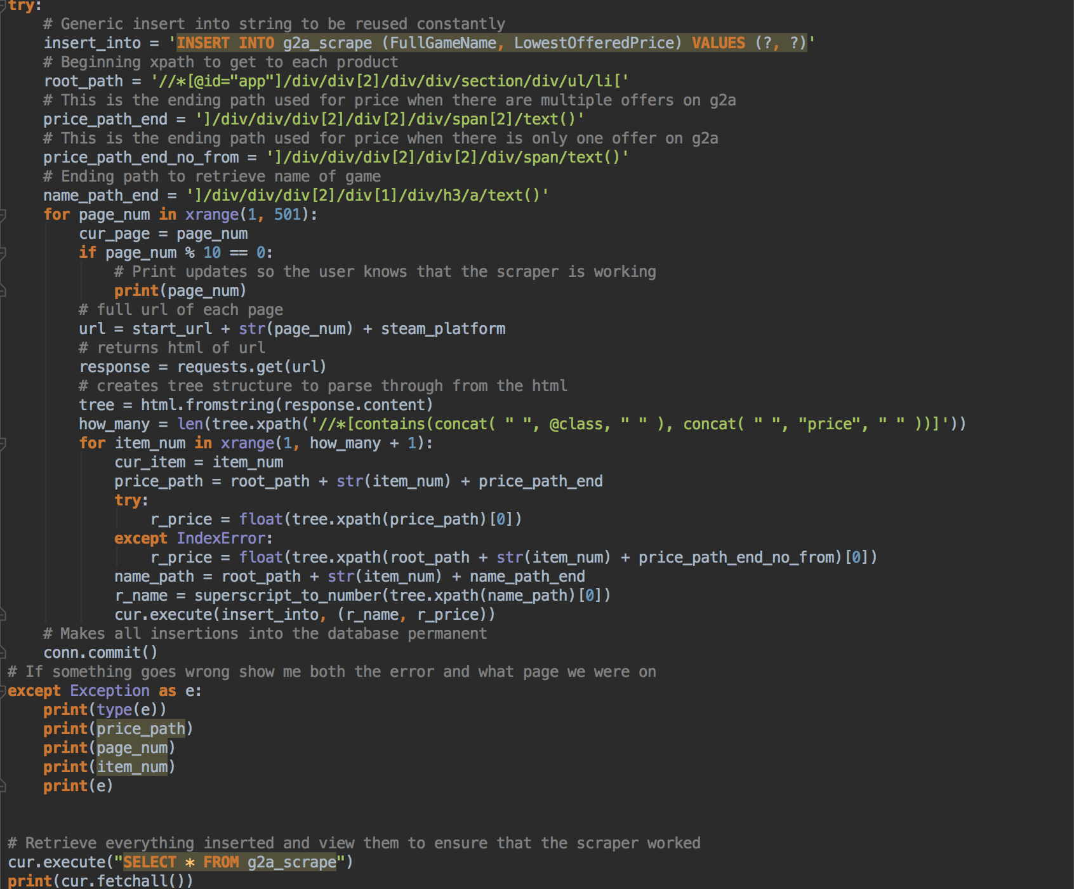
Data Understanding: Collect G2A Data

Slide 7
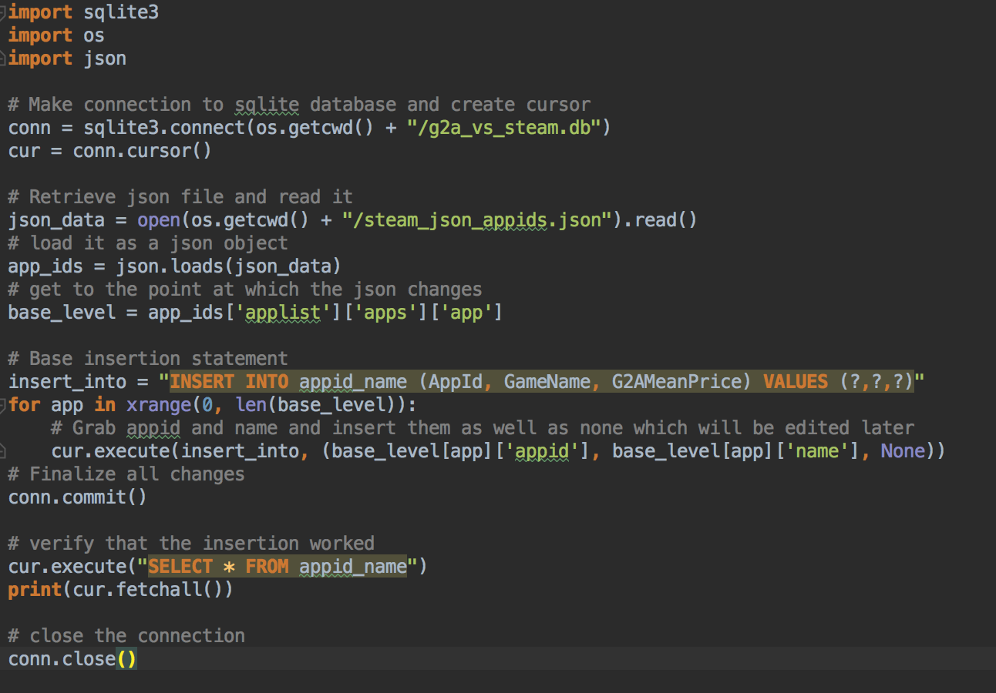
Data Understanding: Collect Steam AppIDs

Slide 8
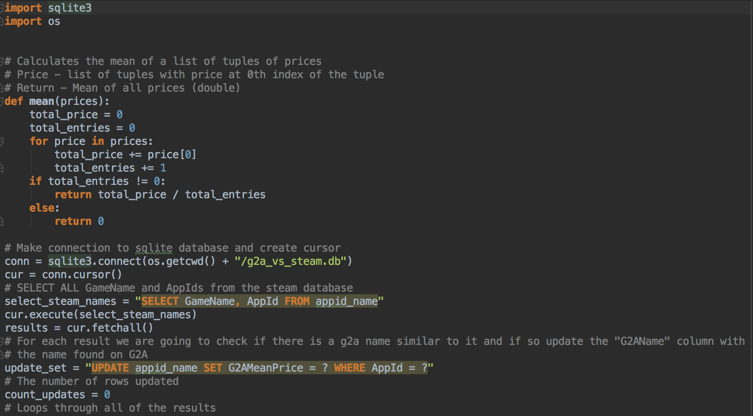
Data Understanding: Matching G2A Name to Steam

Slide 9
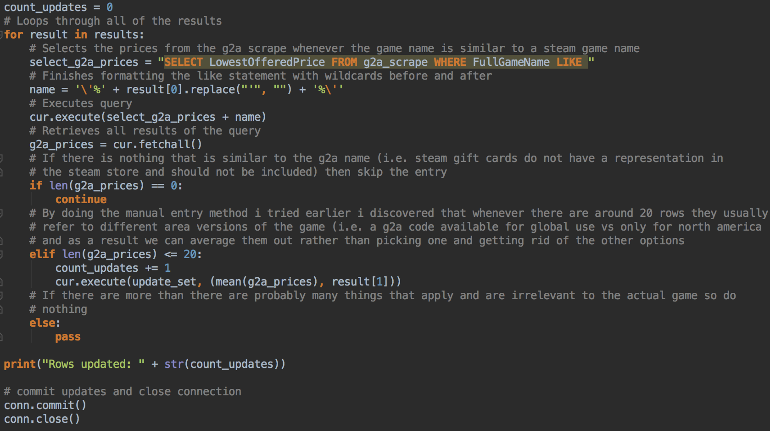
Data Understanding: Matching G2A Name to Steam

Slide 10
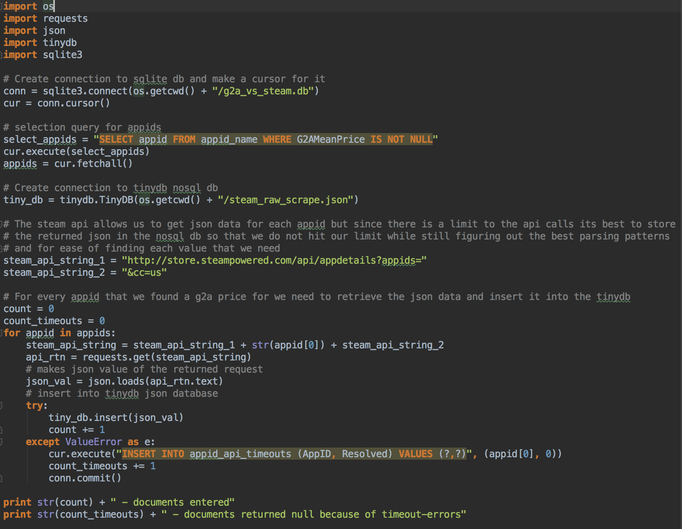
Data Understanding: Scraping Steam

Slide 11
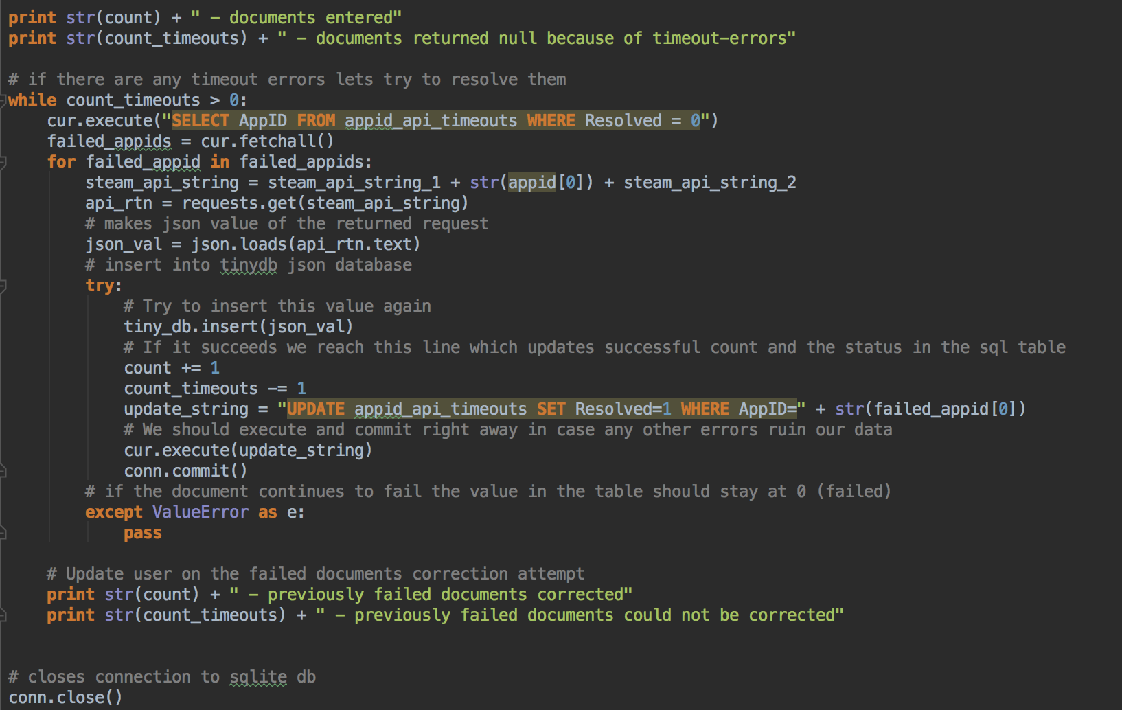
Data Understanding: Scraping Steam

Slide 12
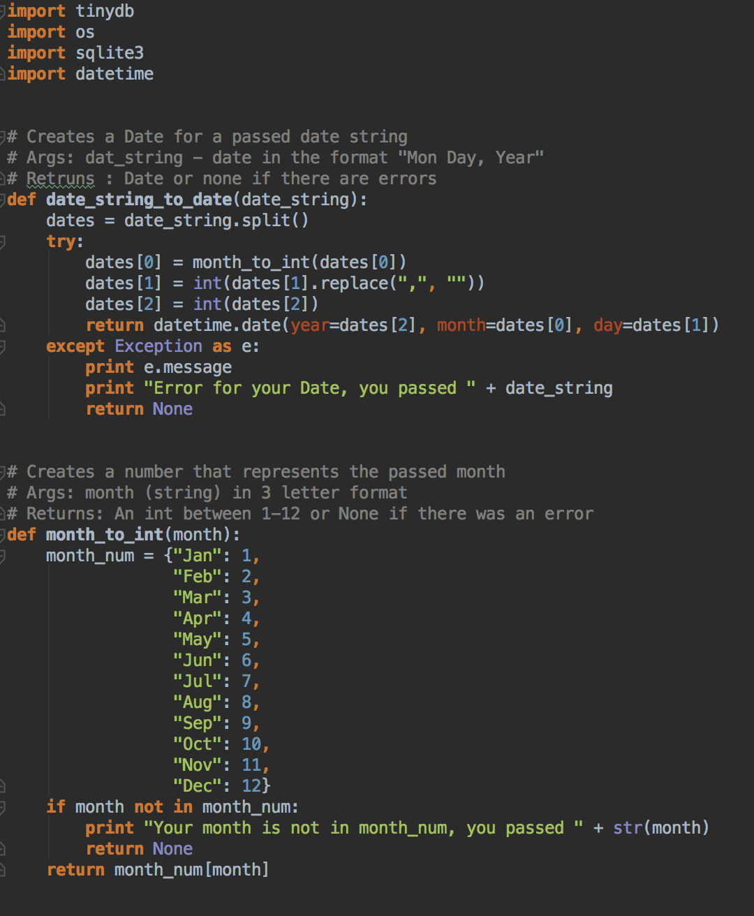
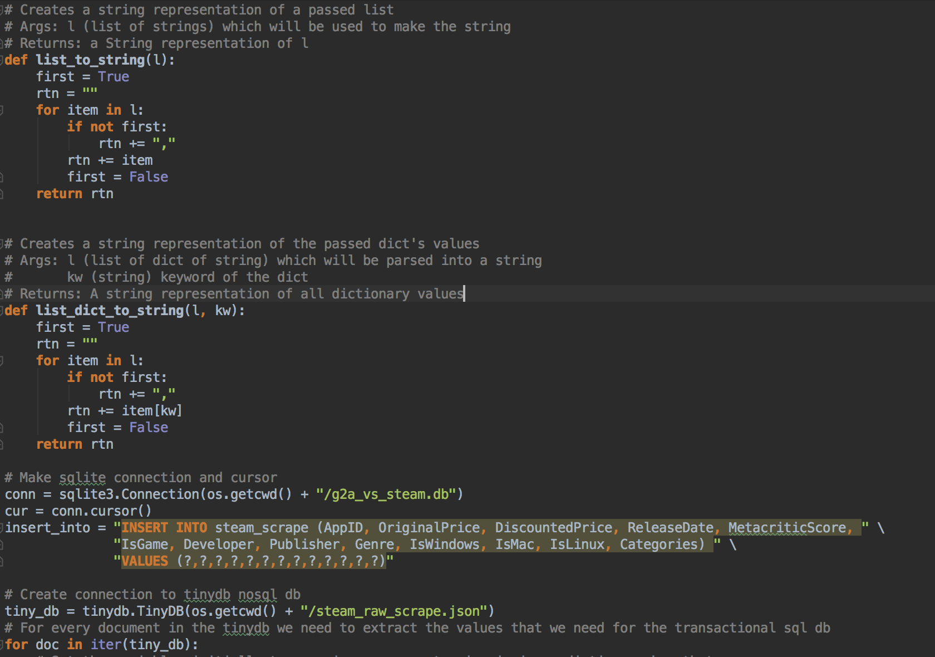
Data Understanding: Parsing Steam JSON

Slide 13
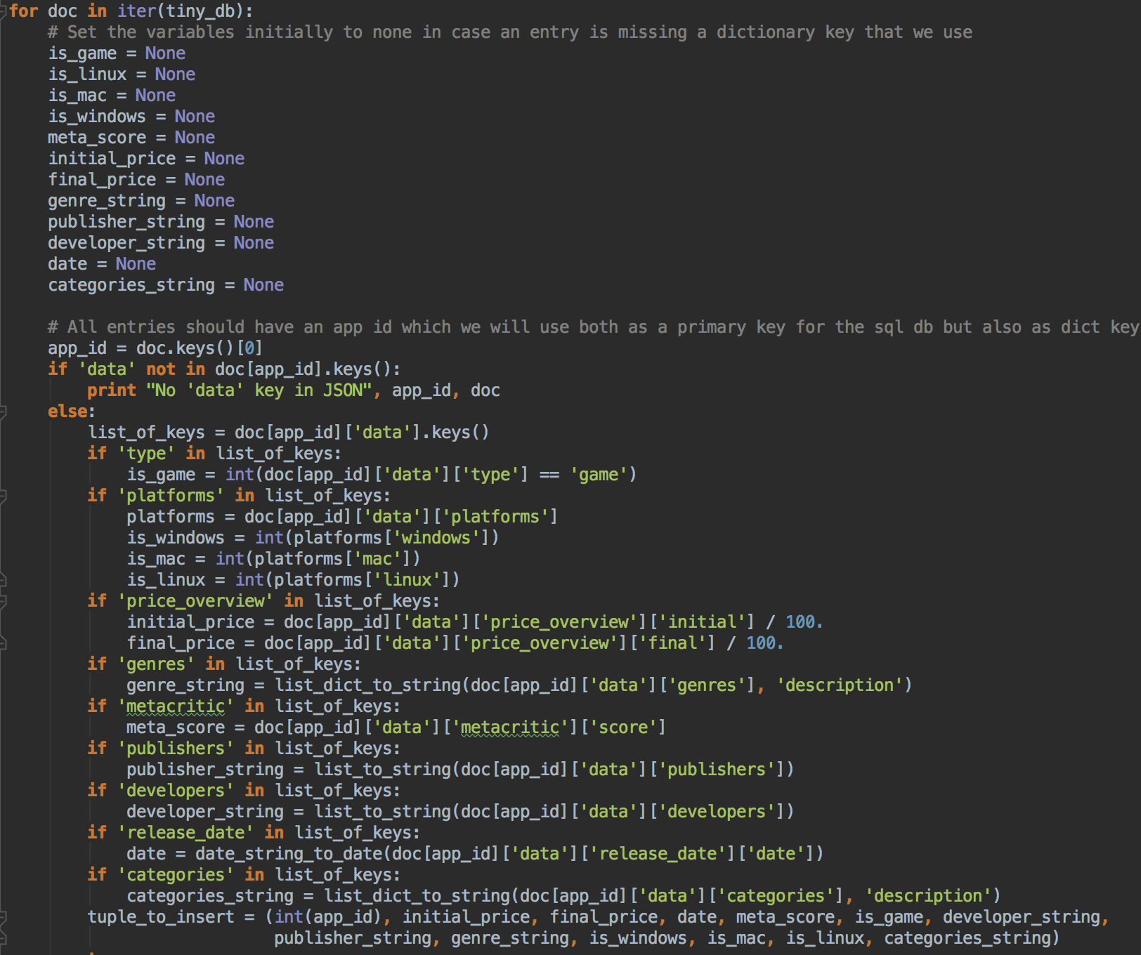
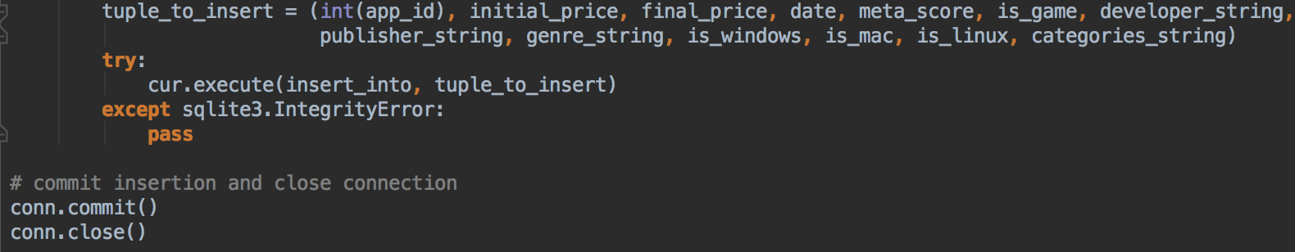
Data Understanding: Parsing Steam JSON

Slide 14
Data Preparation: Transformation
Null Values
Mode of Publisher’s Genre
Missing Publisher = Developer
Drop Metacritic Score
Remove cases without Price
Strings with many fields in them
Make fields – Genre, Categories
Count Number – Publisher, Developer
Categorical ReleaseDate to continuous variable DaysSinceRelease

Slide 15
Data Preparation: Errors in Value
Duplicated Fields
Binary Price Bucket
Outliers – Absolute Z-Score > 3, 33 Removed Original Price, 25 Removed G2AMeanPrice
Correlation – Original Price & G2A Mean Price = 0.4885 (Pearson) 0.4619 (Spearman)
Testing and Training Data Sets

Slide 16
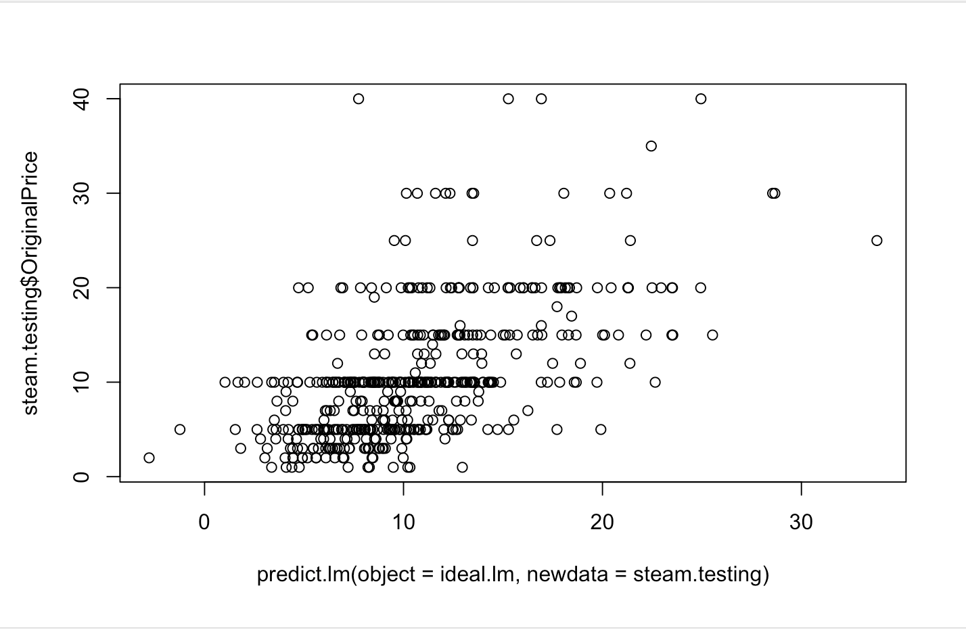
Modeling: Linear Regression
Model With all Variables
Backwards Stepwise Elimination
Adjusted R-Squared = .4281
Plot Of Prediction vs Actual
MAD =4.576598

Slide 17
Modeling: Logistic Regression
Making Price Bucket
Model With All Variables
Stepwise Elimination of Variables for Ideal Model
Accuracy = 80.61%
Statistically Significant Variables Only Model
Accuracy = 81.02%

Slide 18
Data Preparation: Knn Clasification
Min Max Normalization
Days Since Release
G2AMeanPrice
Number Publishers
Number Developers
Initial N Value
Sqrt(67) = 8.185353

Slide 19
Modeling: Knn Classification
Accuracy of Knn at 9 = 96.12%
Accuracy of Knn at 7 = 95.71%
Accuracy of Knn at 5 = 96.73%
Accuracy of Knn at 3 = 95.51%

Slide 20
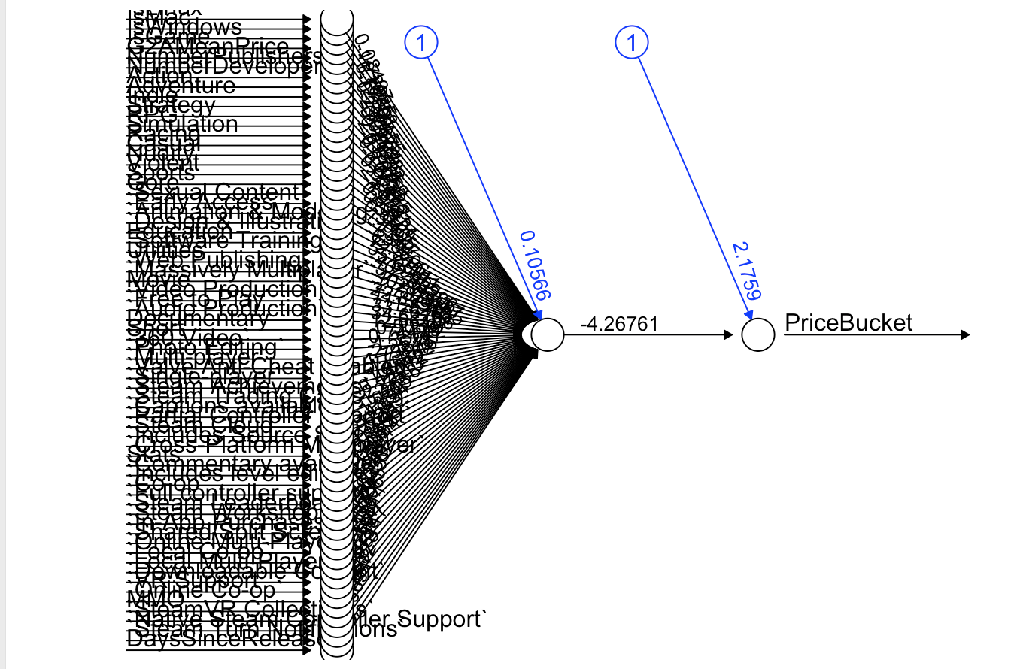
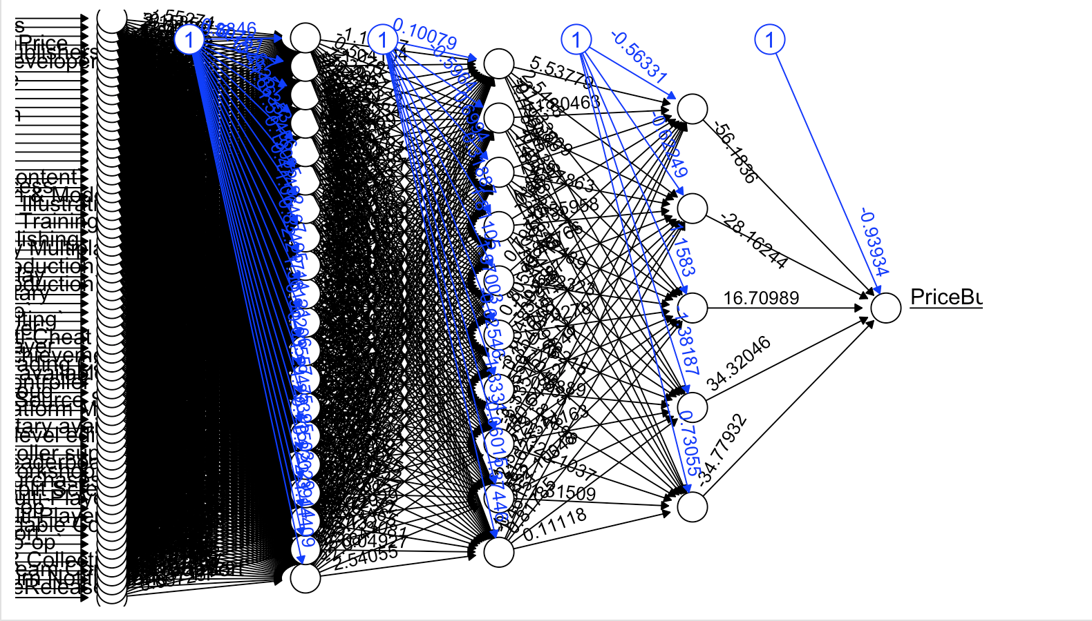
Modeling: ANN
Accuracy of ANN with no hidden nodes = 82.79%
Accuracy of ANN with hidden nodes 20-10-5 = 98.98%

Slide 21
Modeling: SVM
Linear SVM Model Accuracy: 82.04%
Neural Network SVM Model Accuracy: 72.04%

Slide 22
Evaluation
Overall the rankings for best model are:
1. ANN - 98.98%
2. KNN - 96.73%
3. SVM - 82.04%
4. GLM - 81.02%

Slide 23
Thank You For Watching!

